Slide 1
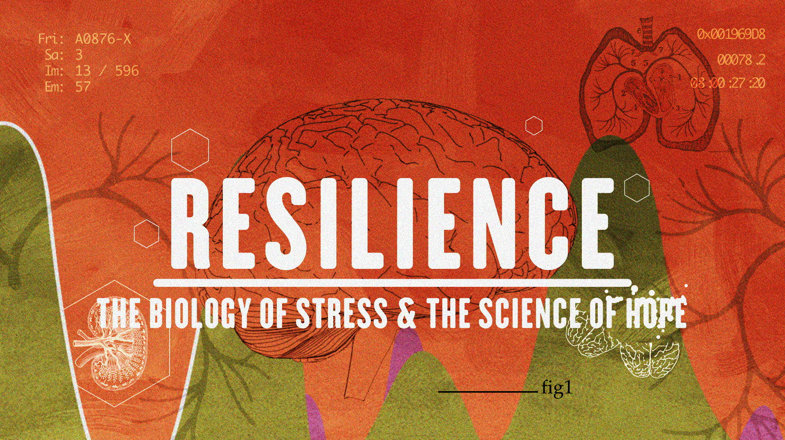
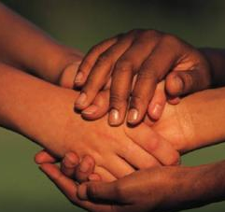
From Toxic Stress to Health, Hope and Resilience Screening and Community Conversation
Moderated by:
Allison Logan BS-ED, MS
Executive Director, Bridgeport Prospers
alogan@unitedwaycfc.org
860-681-6195
Stratford, CT
January 22, 2019

Slide 2
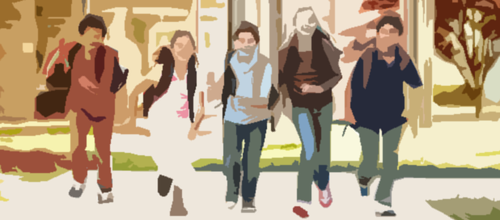
We envision an America where all children can grow up...
Healthy Safe Smart Strong
We are not there now…

Slide 3
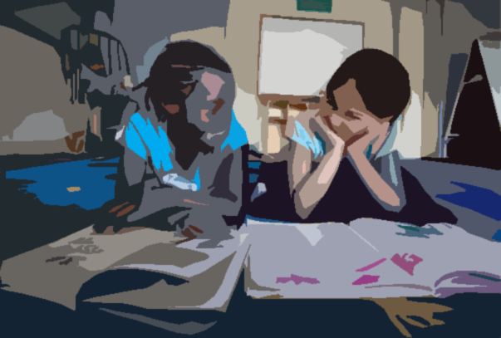
We envision a nation where all children are reading at grade level, measured at the 3rd grade
We are not there yet…

Slide 4
Ascend at the Aspen Institute
We are not there either…

Slide 5
We live and work in a country facing increasing individual trauma and societal stress.
This is not OK

Slide 6
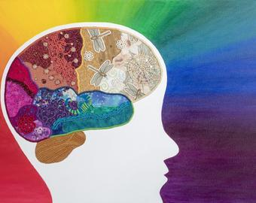
Let the Neuroscience Lead the Way….
What do we KNOW?

Slide 7
We know that all families face some challenges. And some families face many more.
Community violence
Domestic violence
Maternal depression
Parent-child attachment
Substance Abuse
Trauma and Adverse Childhood Experiences (ACES)
Parental Health & Mental Health
Unstable/unsafe housing
Unstable work status
Not enough food to get through the month
Unstable child care
Needs of aging parents
Weak social networks Limited social capital
Developmental delays
Health problems
Anxiety/fear/aggression
School absences including suspension and expulsion
Poor school performance
Child Health, MH and Behavior
Family Basic Needs
janice.gruendel@aya.yale.edu 10.14.17

Slide 8
We know that the impact of trauma and adversity manifests itself in behavior and development…

Slide 9
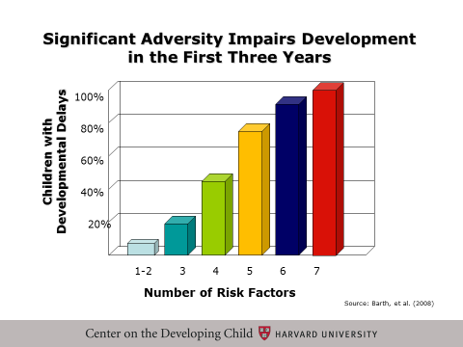
We know that the early years really matter!
The more types of early adversity in the early years, the greater risk of children’s developmental delays before the age of 3.
A child’s developmental delays, language, social-emotional and behavioral challenges can reduce school readiness and hurt academic performance
Living with trauma and toxic stress changes the biology of body and mind across generations.

Slide 10
We know that families with ACES often live in communities with ACES

Slide 11
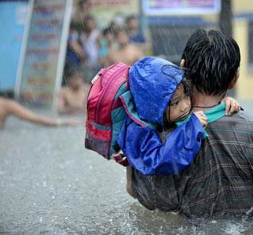
We know… Stress becomes toxic for children when it is not buffered by a caring, predictable adult caregiver in children’s lives
Parents, across generations
Teachers
Mentors
Coaches
Staff in our family-focused helping professions…

Slide 12
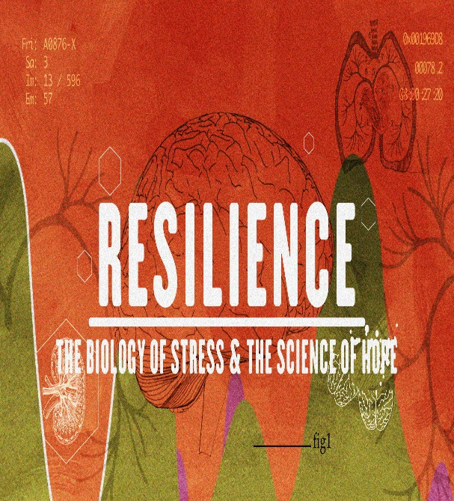
And finally…..WE KNOW communities all over the country are creating very wise actions to move from Trauma to Resilience.
We Can Build It….the first step is awareness.

Slide 13
There will be a panel discussion after the film. Panelists:
Dr. Norman Weinberger- Pediatrician
Tom Brant and Robin Marino- Stratford Public Schools
Ilaria Filippi- Director of Trauma-Informed Schools, Clifford Beers
Use the cards in your folders to write questions for the panel (as they arise for you) during the screening.

Slide 14
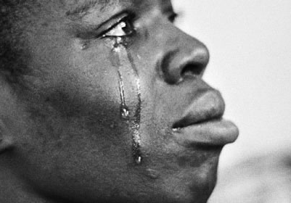
Watch and listen with humility…
because everybody has a story…
This film may surface personal emotions. If you need to speak with someone after the film, a list of local resources is provided for you in your folder.
Also, there are several clinicians here tonight to provide immediate guidance if needed.

Slide 15
Breathe…

Slide 16
What is your ACE Score? Real-Time Poll
Participation is voluntary and anonymous.
Find the ACES Questionnaire in your folder.
Determine total your number.
Go to your web browser on your smart device: Type in
etc.ch/idMi (case sensitive)
After…Please pass your question cards to folks in the aisles

Slide 17
ACEs Poll Results- https://directpoll.com/v?XDVhEtC50Gti7QyVeDnMZxIjOqe7q3
Number of types of ACES | Original ACES study | As Reported in Resilience Video: Convening of Professionals | Stratford Community Conversation
0 | 33% | 24% | 20%
1 | 26% | 16% | 15%
2 | 16% | 13% | 19%
3 | 10% | 13% | 18%
4+ | 16% | 34% | 28%

Slide 18
Panel Discussion

Slide 19
Call To Action!
What are some immediate actions you will take?
As an individual
At your organization
In your community
Share with a partner and fill out your survey!
How can you help to spread the important messages from this film and join the movement to prevent trauma and promote resiliency?

Slide 20
Thank you!
Quotes from the film to take with you……
“By using techniques to allow them [children] to express what their worries are and their stress, to lower their experienced stress, we are going to be able to help them maintain their resilience. And that’s our goal.”
Dr. David Johnson, Clinical Psychologist, Post Traumatic Stress Center
“When you look at ACEs they’re actually a stronger predictor of heart disease than any of the traditional risk factors...and yet I was never trained on this in one day in Medical School.”
Dr. Nadine Burke Harris, Center on Youth Wellness
“We tend to divide the world of mental health separate from the world of physical health, but the body doesn’t do that.”
Dr. Nadine Burke Harris, Center for Youth Wellness
“Scientific research points to the presence of a stable, caring adult in a child’s life as the key to building the skills of resilience.”
- Dr. Jack Shonkoff, Harvard University

